Slide 1
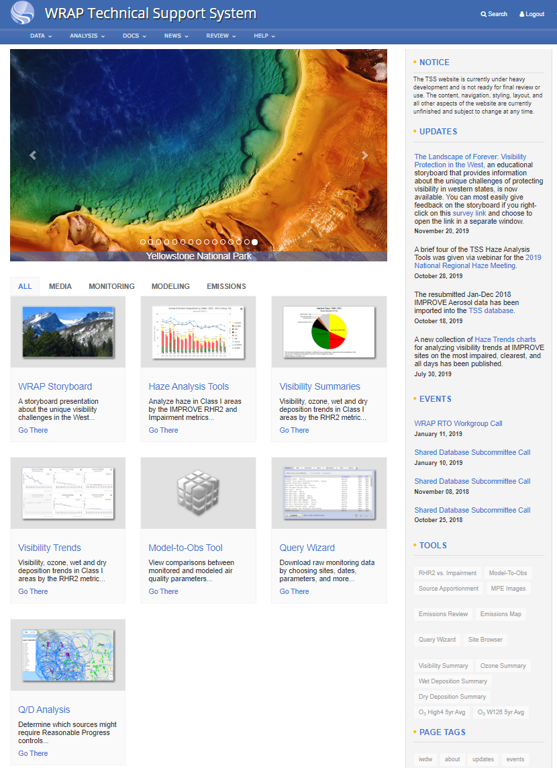
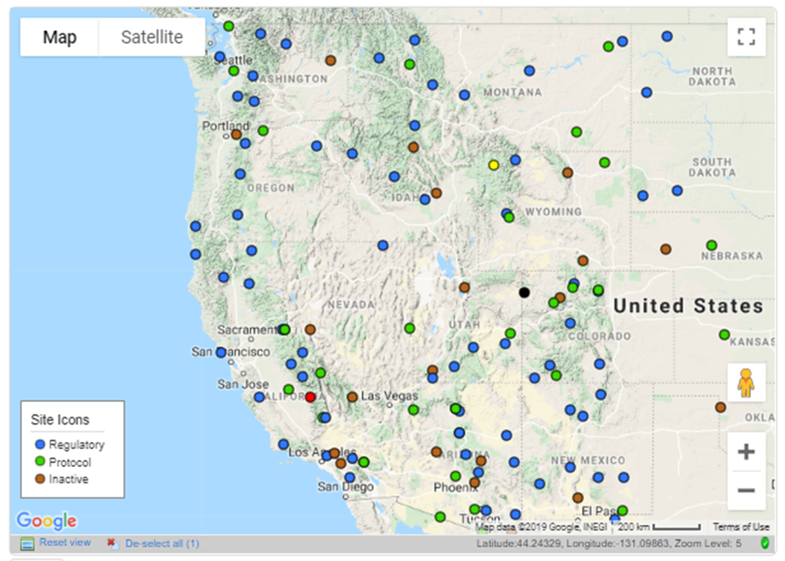
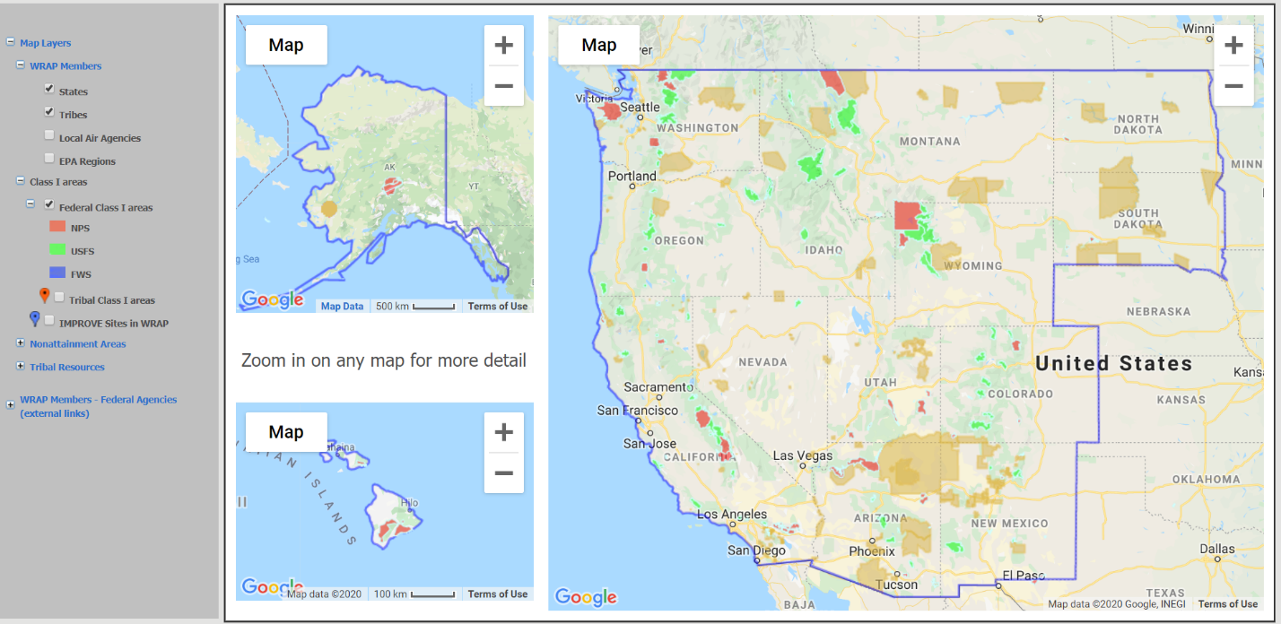
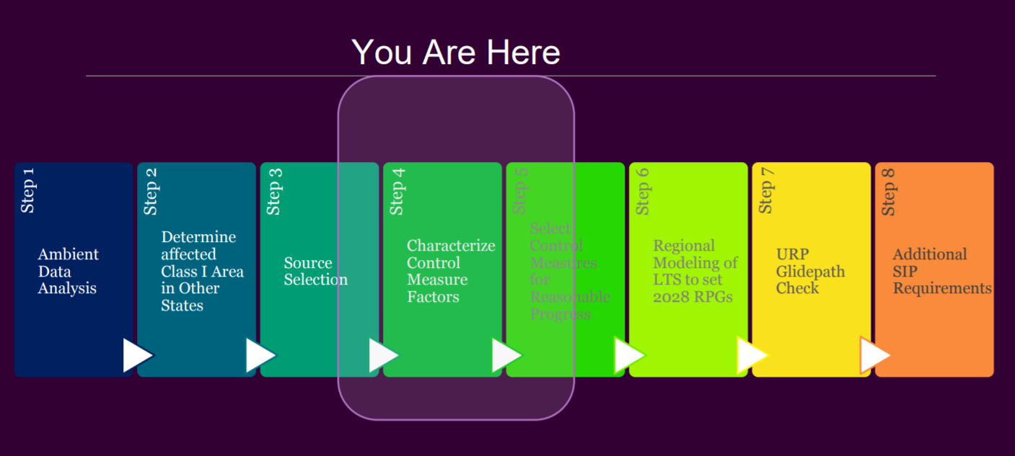
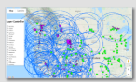
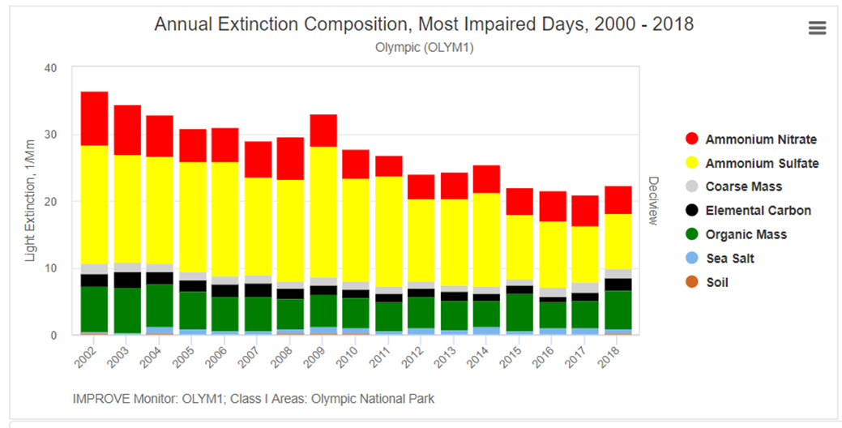
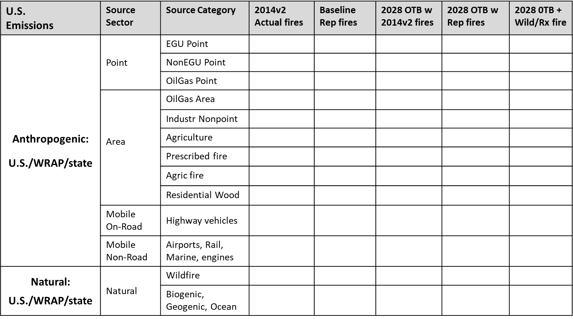
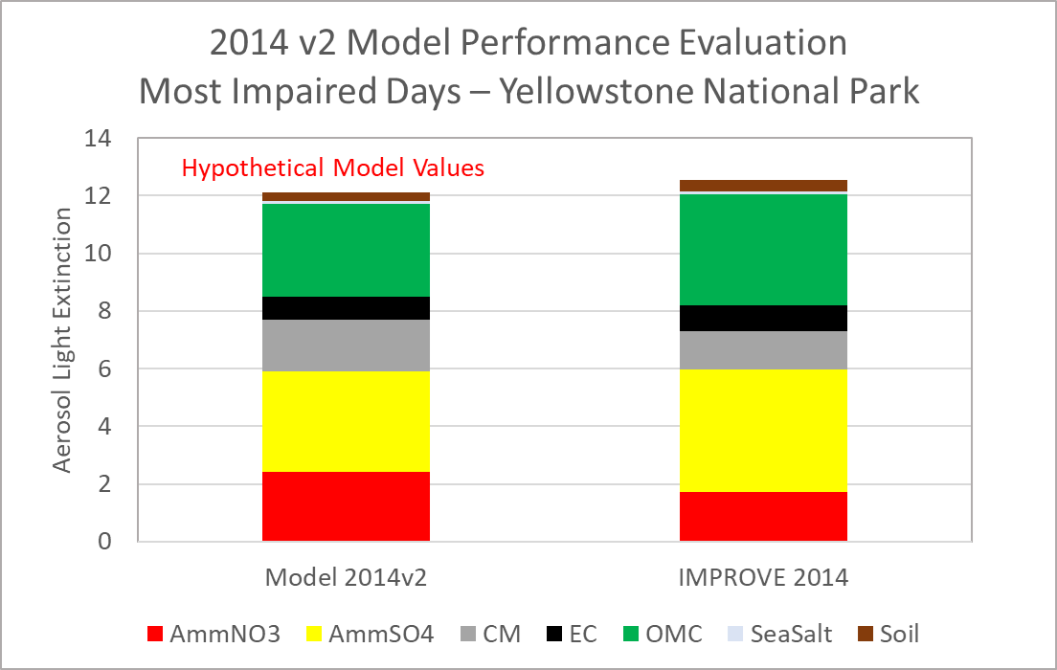
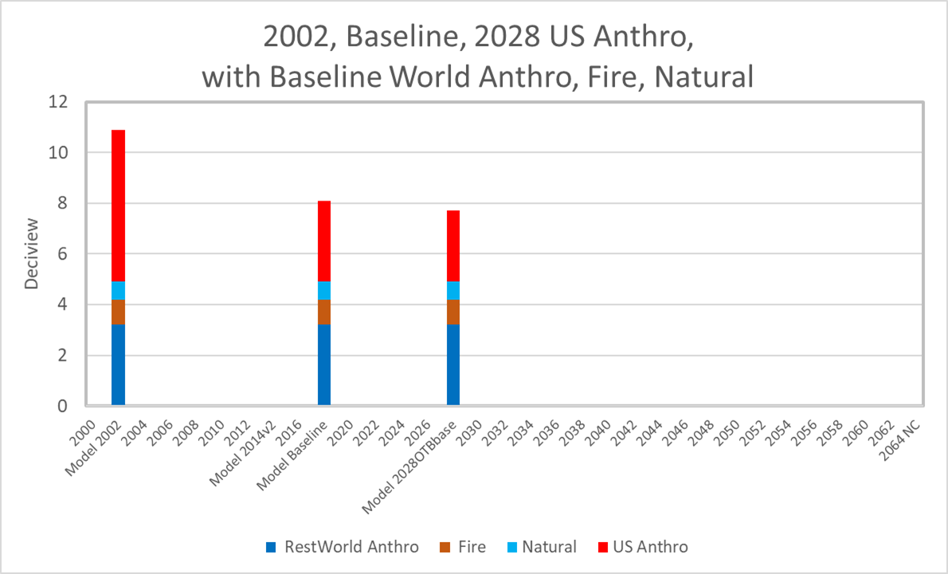
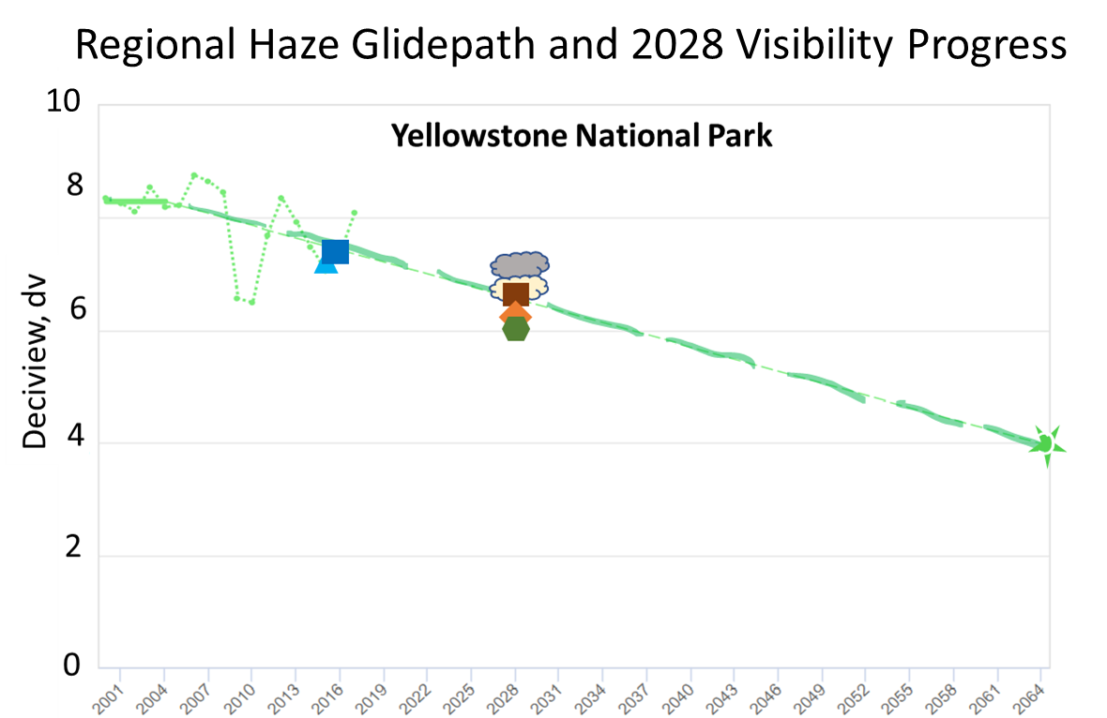
WRAP TSS Delivery Draft version 4 Coordination and Glidepath Subcommittee February 13, 2020
Class I Area Summary Tables
Summary Tables for monitoring, emissions contributions, and modeled 2928 visibility progress.
Go There
SIP Planning Steps
User’s Guide to technical analyses supporting Regional Haze State Implementation Plans
Go There
WRAP Support for Regional Haze Planning Actions
Emission Control
Evaluation
Fire and Smoke
Management
Consultation among
States, Tribes,
Federal Land
Managers
Monitoring Plan (?)
Visibility Analyses
Evaluate IMPROVE aerosol trends at Class I areas
Go There
Emissions Inventories
Pollutant Inventories by source sector as used in regional air quality models.
Go There
Source Screening
Ranking 2014 Point Sources by emissions / distance (Q/d) and
2028 Point Sources by Weighted Emissions Potential (WEP)
Go There
Website Links:
WRAP
IWDW
FED
Fire Tools
2014 Air Quality Model vs Observations
Compare monitored and modeled aerosol contributions at Class I areas
Go There
Source Sector Contributions
Attribute US and International Anthropogenic, Fire, Natural using Source Apportionment (PSAT) and Dynamic Modeling
Go There
2028 Visibility Progress and Glidepath
2028 modeled visibility and
2028 visibility progress compared to uniform rate of progress glidepath
Go There

Slide 2
WRAP Technical Support System Users Guide
TSS Users Guide describes WRAP products supporting SIP Steps 1,2, 6 and 7.
States have lead responsibility for Steps 3, 4, 5, and 8.
Coord + Glidepath
RTO/Control Measures
States
RTO/Em+ Protocol
RTO/Coord + Glidepath
States
Steps follow RHR and EPA Guidance
Review, Coordination, Consultation
Coordination + Glidepath

Slide 3
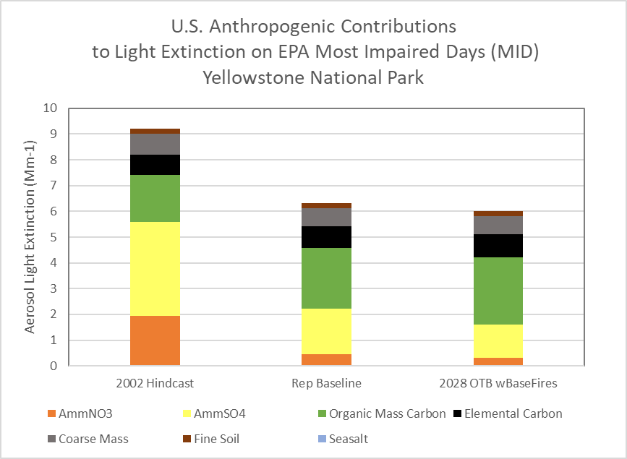
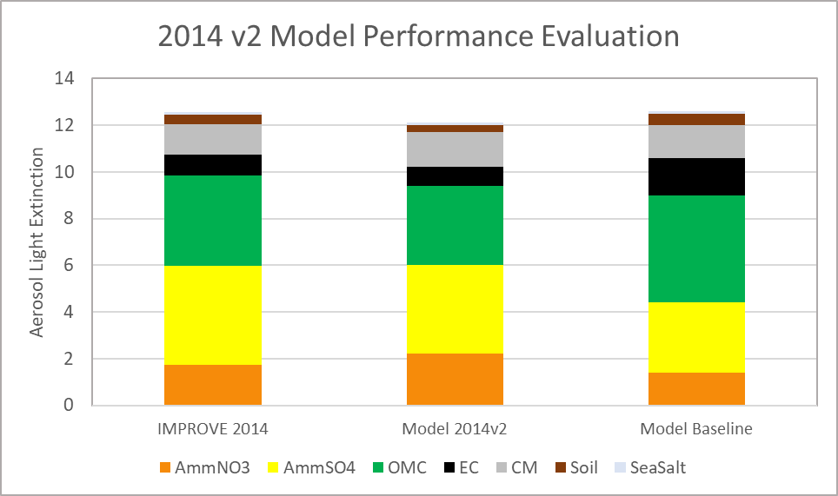
Navigating TSS Homepage
TSS Users Guide to SIP Planning Steps:
First Priority: Outline displays tables and charts supporting regional haze planning steps 1, 2, 6, and 7.
Second Priority: Method Descriptions
First Priority:
Class I Area Tables for:
Monitored visibility progress 2000-2018
Emissions - WRAP State and Tribal
Source contributions
Modeled visibility progress by 2028.
SIP Planning Steps
User’s Guide to technical analyses supporting Regional Haze State Implementation Plans
Go There
Class I Area Summary Tables
Summary Tables for monitoring, emissions contributions, and modeled 2928 visibility progress.
Go There
SIP Planning Steps
User’s Guide to technical analyses supporting Regional Haze State Implementation Plans
Go There
Class I Area Summary Tables
Summary Tables for monitoring, emissions contributions, and modeled 2928 visibility progress.
Go There
WRAP Support for State Regional Haze Planning Actions
Emission Control
Evaluation
Fire and Smoke
Management
Consultation among
States, Tribes,
Federal Land
Managers
Monitoring Plan (?)
WRAP Support for State Regional Haze Planning Actions
Emission Control
Evaluation
Fire and Smoke
Management
Consultation among
States, Tribes,
Federal Land
Managers
Monitoring Plan (?)
Source Screening
Ranking 2014 Point Sources by emissions / distance (Q/d) and
2028 Point Sources by Weighted Emissions Potential (WEP)
Go There
Emissions Inventories
Pollutant Inventories by source sector as used in regional air quality models.
Go There
Source Screening
Ranking 2014 Point Sources by emissions / distance (Q/d) and
2028 Point Sources by Weighted Emissions Potential (WEP)
Go There
Visibility Analyses
Evaluate IMPROVE aerosol trends at Class I areas
Go There
Emissions Inventories
Pollutant Inventories by source sector as used in regional air quality models.
Go There
Visibility Analyses
Evaluate IMPROVE aerosol trends at Class I areas
Go There
Website Links:
WRAP
IWDW
FED
Fire Tools
2028 Visibility Progress and Glidepath
2028 modeled visibility and
2028 visibility progress compared to uniform rate of progress glidepath
Go There
Emissions Source Contributions
Attribute US and International Anthropogenic, Fire, Natural using Source Apportionment (PSAT) and Dynamic Modeling
Go There
2028 Visibility Progress and Glidepath
2028 modeled visibility and
2028 visibility progress compared to uniform rate of progress glidepath
Go There
Air Quality Model Results
Model performance evaluation and modeled aerosol contributions at Class I areas in 2014, Rep Baseline, and 2028 scenarios
Go There
Emissions Source Contributions
Attribute US and International Anthropogenic, Fire, Natural using Source Apportionment (PSAT) and Dynamic Modeling
Go There
Air Quality Model Results
Model performance evaluation and modeled aerosol contributions at Class I areas in 2014, Rep Baseline, and 2028 scenarios
Go There

Slide 4
Navigating TSS Homepage
First Priority:
Outline for TSS Users Guide to SIP Planning Steps:
First Priority:
Class I Area Summary Tables
Class I Area Summary Tables
Summary Tables for monitoring, emissions contributions, and modeled 2928 visibility progress.
Go There
SIP Planning Steps
User’s Guide to technical analyses supporting Regional Haze State Implementation Plans
Go There
WRAP Support for State Regional Haze Planning Actions
Emission Control
Evaluation
Fire and Smoke
Management
Consultation among
States, Tribes,
Federal Land
Managers
Monitoring Plan (?)
Second Priority:
SIP Steps 1, 2, 6, and 7: Charts and Tables
Monitored visibility progress
Emissions: 2014v2, RepBaseline, 2028 OTB
Modeled visibility progress by 2028 OTB.
Source Contributions
Glidepath
Visibility Analyses
Evaluate IMPROVE aerosol trends at Class I areas
Go There
Emissions Inventories
Pollutant Inventories by source sector as used in regional air quality models.
Go There
Source Screening
Ranking 2014 Point Sources by emissions / distance (Q/d) and
2028 Point Sources by Weighted Emissions Potential (WEP)
Go There
Website Links:
WRAP
IWDW
FED
Fire Tools
Air Quality Model Results
Model performance evaluation and modeled aerosol contributions at Class I areas in 2014, Rep Baseline, and 2028 scenarios
Go There
Emissions Source Contributions
Attribute US and International Anthropogenic, Fire, Natural using Source Apportionment (PSAT) and Dynamic Modeling
Go There
2028 Visibility Progress and Glidepath
2028 modeled visibility and
2028 visibility progress compared to uniform rate of progress glidepath
Go There

Slide 5
Navigating TSS Homepage
First Priority:
TSS Users Guide to SIP Planning Steps:
First Priority:
Class I Area Summary Tables
Class I Area Summary Tables
Summary Tables for monitoring, emissions contributions, and modeled 2928 visibility progress.
Go There
SIP Planning Steps
User’s Guide to technical analyses supporting Regional Haze State Implementation Plans
Go There
WRAP Support for State Regional Haze Planning Actions
Emission Control
Evaluation
Fire and Smoke
Management
Consultation among
States, Tribes,
Federal Land
Managers
Monitoring Plan (?)
Third Priority:
Redesign Right Navigation area:
Add Links to other WRAP webpages supporting SIP Steps 3, 4, 5, and 8 (which are state-led activities.)
Delete Outdated Events, tools
Second Priority:
SIP Steps 1, 2, 6, and 7: Charts and Tables
Visibility Analyses
Evaluate IMPROVE aerosol trends at Class I areas
Go There
Emissions Inventories
Pollutant Inventories by source sector as used in regional air quality models.
Go There
Source Screening
Ranking 2014 Point Sources by emissions / distance (Q/d) and
2028 Point Sources by Weighted Emissions Potential (WEP)
Go There
Website Links:
WRAP
IWDW
FED
Fire Tools
Air Quality Model Results
Model performance evaluation and modeled aerosol contributions at Class I areas in 2014, Rep Baseline, and 2028 scenarios
Go There
Emissions Source Contributions
Attribute US and International Anthropogenic, Fire, Natural using Source Apportionment (PSAT) and Dynamic Modeling
Go There
2028 Visibility Progress and Glidepath
2028 modeled visibility and
2028 visibility progress compared to uniform rate of progress glidepath
Go There

Slide 6
Class I Area Summary Tables
Class I Summary
Visibility Trends
Emissions
2028 Visibility Progress
Source Sector Contributions
Glidepath
Select Class I area, State, Tribe, or FLM

Slide 7
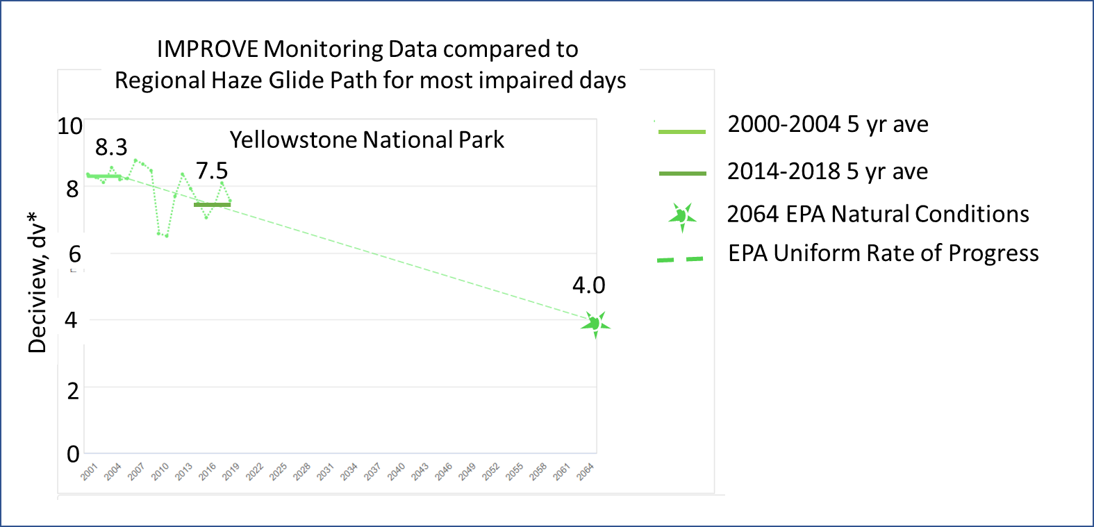
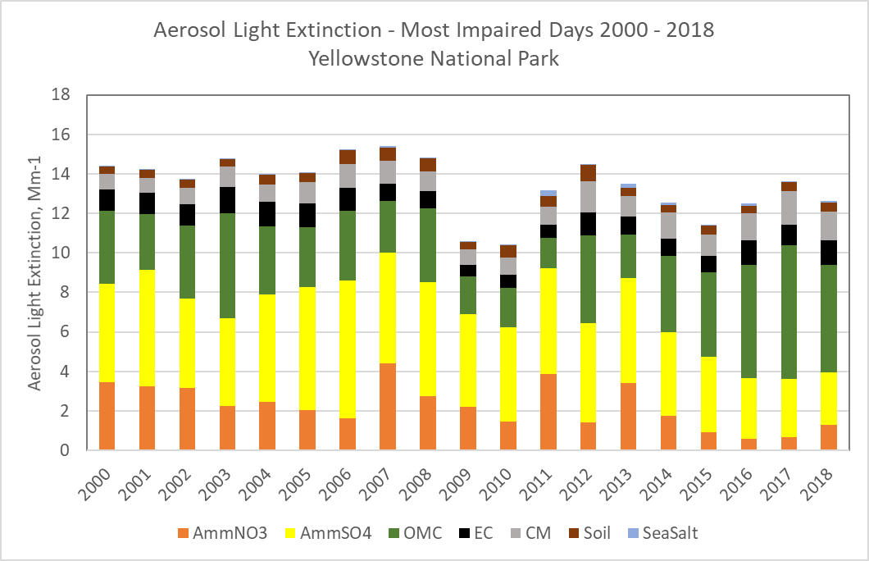
SIP Step 1
(for Most Impaired Days and Clearest Days)
dv
dv
Haze Analyses
Evaluate IMPROVE aerosol trends at Class I areas
Go There
dv
Direct questions
and comments to
Coordination and
Glidepath
Subcommittee

Slide 8
Step 2 Emissions Contributions
Emissions Inventories based on emission model outputs
Nitrogen Oxides
Sulfur Oxides
Ammonia
Total
PM2.5
PM Organic Aerosol
Coarse
PM10
VOC
For each of 12 WRAP states: (Different tables for CA, AK, HI)
Ramboll to deliver
model inventory to CIRA.
CIRA displays inventory on
Intermountain West Data
Warehouse.
CIRA processes inventory
for TSS displays
Direct questions and
comments to Emissions
Inventory and Modeling
Protocol Subcommittee.
State Emissions | Source Category | 2014v2 Actual | Representative Baseline | 2028 OTB w 2014v2 fires | 2028 OTB w Rep Base fires
Anthropogenic | EGU Point
Anthropogenic | Oil&Gas Point
Anthropogenic | Remaining Non-EGU Point
Anthropogenic | Oil&Gas Non-point
Anthropogenic | Agriculture
Anthropogenic | Remaining Non-point
Anthropogenic | Prescribed Fire
Anthropogenic | Agricultural Fire
Anthropogenic | Residential Wood Combustion
Anthropogenic | Fugitive dust
Anthropogenic | On-Road Mobile
Anthropogenic | Marine Shipping
Anthropogenic | Rail
Anthropogenic | Non-road Mobile
Natural | Biogenic
Natural | Wildfire
Natural | Lightning NOx
Natural | Oceanic

Slide 9
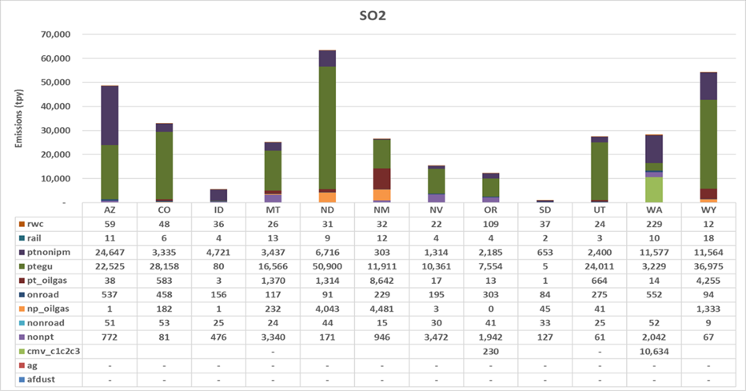
Step 2 Emissions Contributions
Emissions Inventories based on emission model outputs
Nitrogen Oxides
Sulfur Oxides
Ammonia
Total
PM2.5
PM Organic Aerosol
Coarse
PM10
VOC
WRAP 2014v2 Modeling Inventory
Ramboll to deliver
model inventory to CIRA.
CIRA displays inventory on
Intermountain West Data
Warehouse.
CIRA processes inventory
for TSS displays
Direct questions and
comments to Emissions
Inventory and Modeling
Protocol Subcommittee.

Slide 10
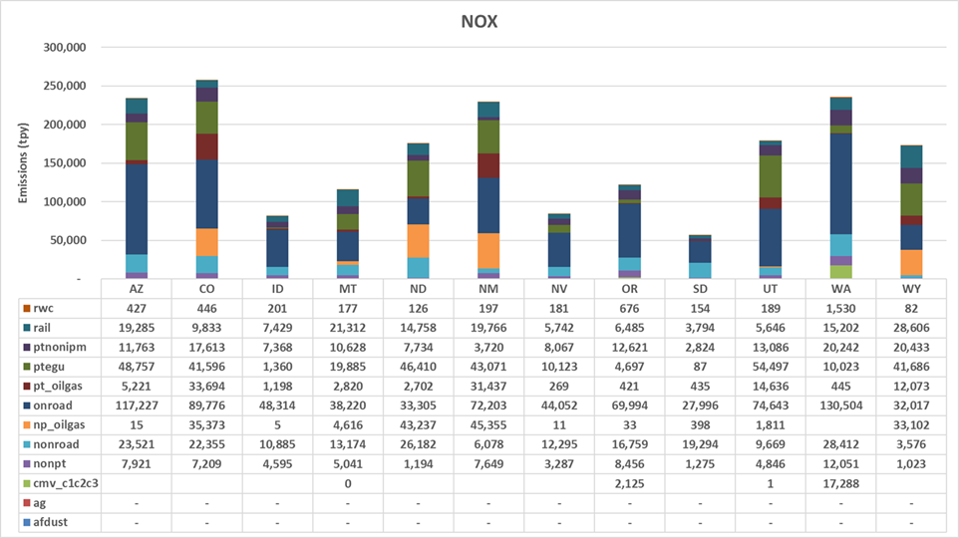
Step 2 Emissions Contributions
Emissions Inventories based on emission model outputs
Nitrogen Oxides
Sulfur Oxides
Ammonia
Total
PM2.5
PM Organic Aerosol
Coarse
PM10
VOC
WRAP 2014v2 Inventory
Ramboll to deliver
model inventory to CIRA.
CIRA displays inventory on
Intermountain West Data
Warehouse.
CIRA processes inventory
for TSS displays
Direct questions and
comments to Emissions
Inventory and Modeling
Protocol Subcommittee.

Slide 11
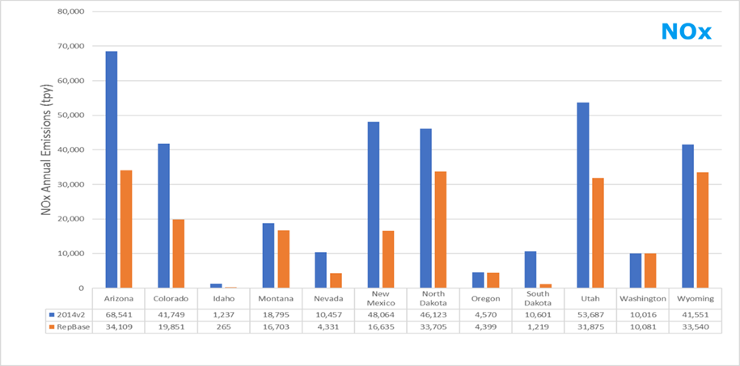
Step 2 Emissions Contributions
Emissions Inventories based on emission model outputs
Nitrogen Oxides
Sulfur Oxides
Ammonia
Total
PM2.5
PM Organic Aerosol
Coarse
PM10
VOC
Comparison of WRAP 2014v2 and Representative Baseline Inventories
Ramboll to deliver
model inventory to CIRA.
CIRA displays inventory on
Intermountain West Data
Warehouse.
CIRA processes inventory
for TSS displays
Direct questions and
comments to Emissions
Inventory and Modeling
Protocol Subcommittee.

Slide 12
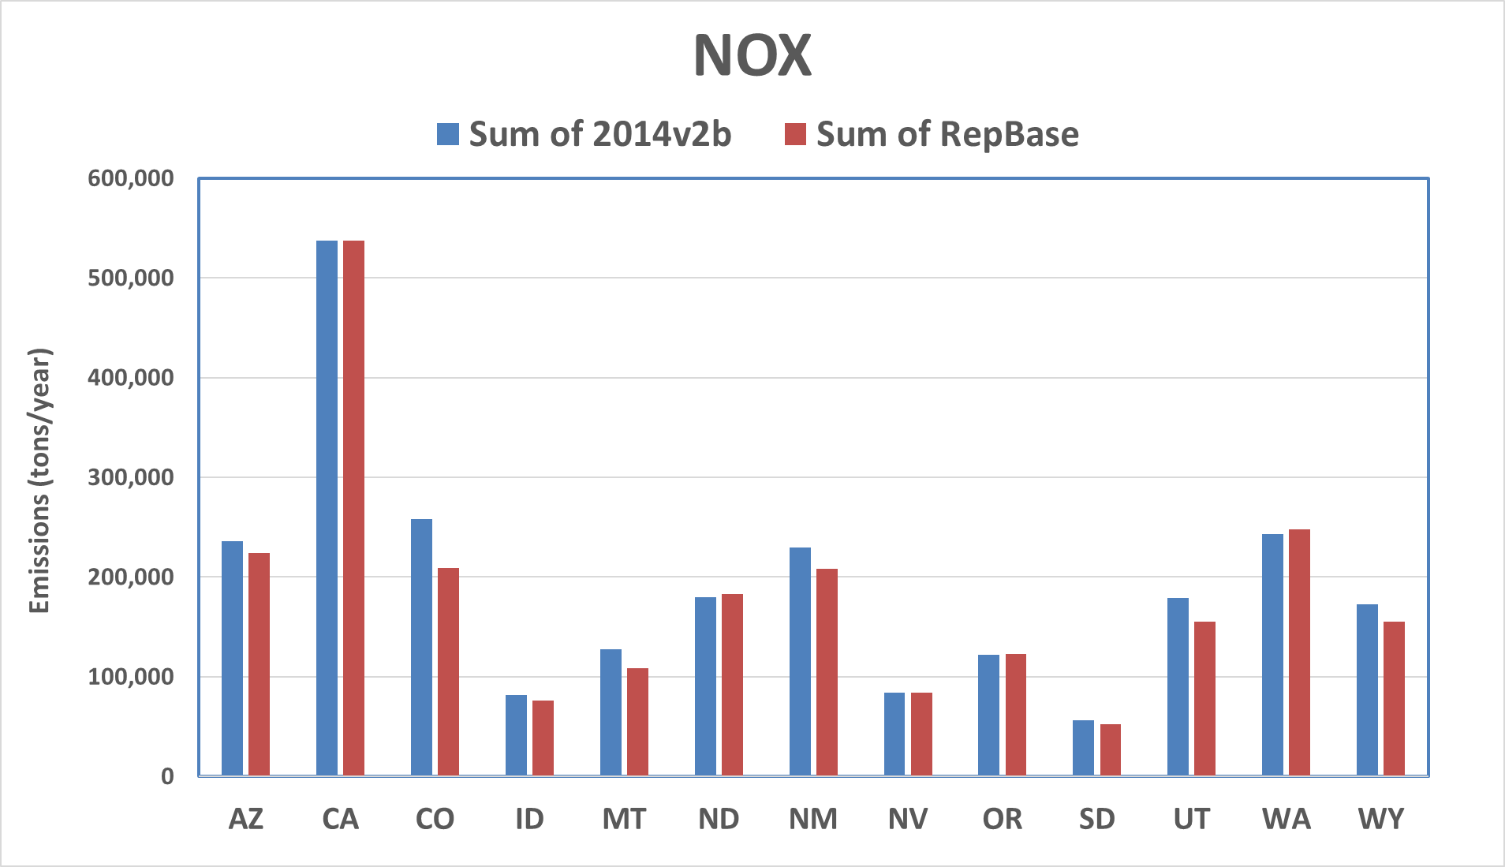
Step 2 Emissions Contributions
Emissions Inventories based on emission model outputs
Nitrogen Oxides
Sulfur Oxides
Ammonia
Total
PM2.5
PM Organic Aerosol
Coarse
PM10
VOC
Comparison of WRAP 2014v2 and Rep Baseline U.S. Anthropogenic Inventories
Ramboll to deliver
model inventory to CIRA.
CIRA displays inventory on
Intermountain West Data
Warehouse.
CIRA processes inventory
for TSS displays
Direct questions and
comments to Emissions
Inventory and Modeling
Protocol Subcommittee.

Slide 13
Step 6: Modeling Long Term Strategy
Model vs Observations: :
Model Design
Daily
Most Impaired Days
Clearest Days
By Pollutant
2014 Air Quality Model vs Observations
Compare monitored and modeled aerosol contributions at Class I areas
Go There
Hypothetical model values
Direct questions and
comments to Regional
Technical Operations
Workgroup

Slide 14
Step 6: Source Sector Contributions
Dynamic Modeling and 2028 Source Apportionment
Model Design
2002 US Anthro
Rep Baseline
2028 OTB
2028 Source Contributions
2002
2028 OTB
Source Sector Contributions
Attribute US and International Anthropogenic, Fire, Natural using Source Apportionment (PSAT) and Dynamic Modeling
Go There
Hypothetical model values
Direct questions and
comments to Regional
Technical Operations
Workgroup

Slide 15
Step 6: Source Sector Contributions
Dynamic Modeling and 2028 Source Apportionment
Model Design
2002 US Anthro
Rep Baseline
2028 OTB
2028 Source Contributions
2002
2028 OTB
Source Sector Contributions
Attribute US and International Anthropogenic, Fire, Natural using Source Apportionment (PSAT) and Dynamic Modeling
Go There
Hypothetical model values
Direct questions and comments
to Regional
Technical Operations
Workgroup
Natural

Slide 16
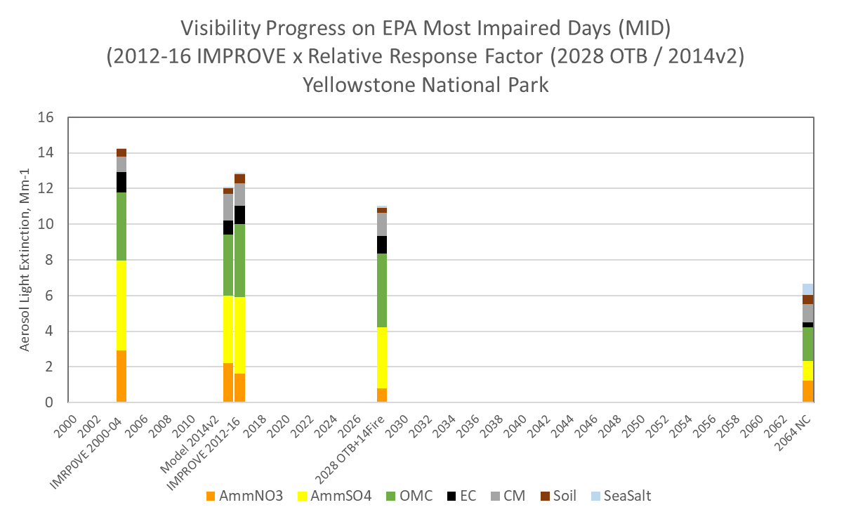
Step 7 Visibility Progress compared to Glidepath
Visibility Progress:
2028 OTB w
14v2 Fires
2028 OTW w
Base Fires
Other 2028 Scenarios
Glidepath
International Contribution
2028 Visibility Progress and Glidepath
2028 modeled visibility and
2028 visibility progress compared to uniform rate of progress glidepath
Go There
Direct questions
and comments to Regional Technical
Operations Workgroup

Slide 17
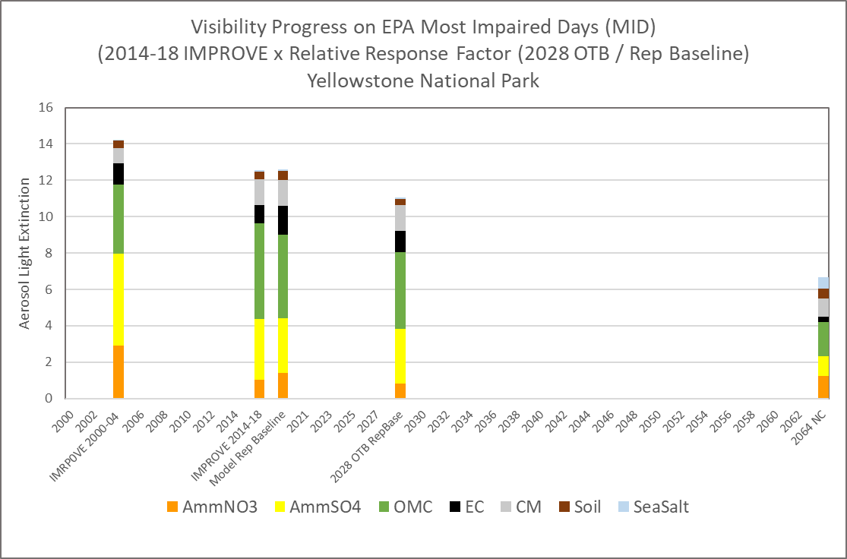
Step 7 Visibility Progress compared to Glidepath
Visibility Progress:
2028 OTB w
14v2 Fires
2028 OTW w
Base Fires
Other 2028 Scenarios
Glidepath
International Contribution
2028 Visibility Progress and Glidepath
2028 modeled visibility and
2028 visibility progress compared to uniform rate of progress glidepath
Go There
Direct questions
and comments to Regional Technical
Operations Workgroup

Slide 18
Step 7 Visibility Progress compared to Glidepath
Visibility Progress:
2028 OTB w
14v2 Fires
2028 OTW w
Base Fires
Other 2028 Scenarios
Glidepath
International Contribution
2028 Visibility Progress and Glidepath
2028 modeled visibility and
2028 visibility progress compared to uniform rate of progress glidepath
Go There
Direct questions
and comments to Regional Technical
Operations Workgroup

Slide 19
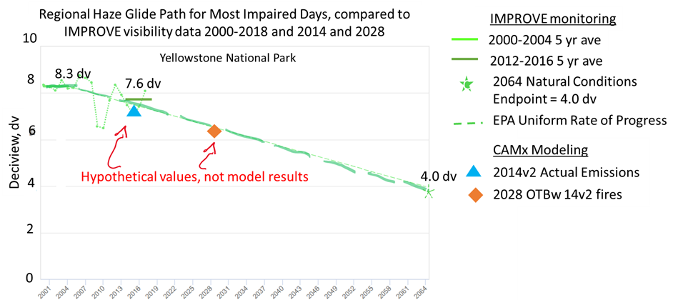
Step 7 Visibility Progress compared to Glidepath
Visibility Progress:
2028 OTB w
14v2 Fires
2028 OTW w
Base Fires
Other 2028 Scenarios
Glidepath
2028 Visibility Progress and Glidepath
2028 modeled visibility and
2028 visibility progress compared to uniform rate of progress glidepath
Go There
Direct questions
and comments to Regional Technical
Operations Workgroup

Slide 20
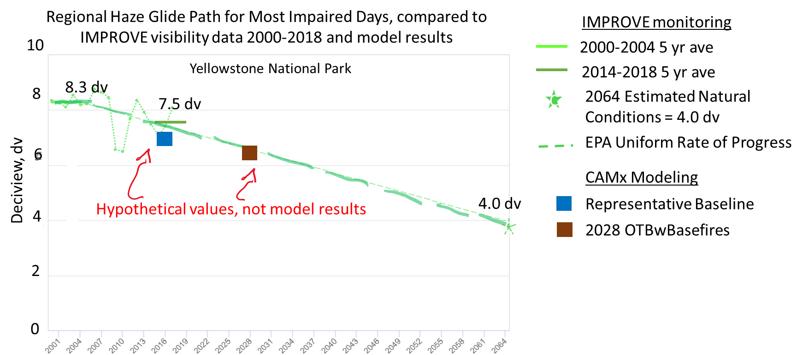
Step 7 Visibility Progress compared to Glidepath
Visibility Progress:
2028 OTB w
14v2 Fires
2028 OTW w
Base Fires
Other 2028 Scenarios
Glidepath
2028 Visibility Progress and Glidepath
2028 modeled visibility and
2028 visibility progress compared to uniform rate of progress glidepath
Go There
Direct questions
and comments to Regional Technical
Operations Workgroup

Slide 21
Step 7 Visibility Progress compared to Glidepath
Visibility Progress:
2028 OTB w
14v2 Fires
2028 OTW w
Base Fires
By Pollutant
Glidepath
2028 Visibility Progress and Glidepath
2028 modeled visibility and
2028 visibility progress compared to uniform rate of progress glidepath
Go There
Direct questions
and comments to Coordination and Glidepath Subcommittee

Slide 22
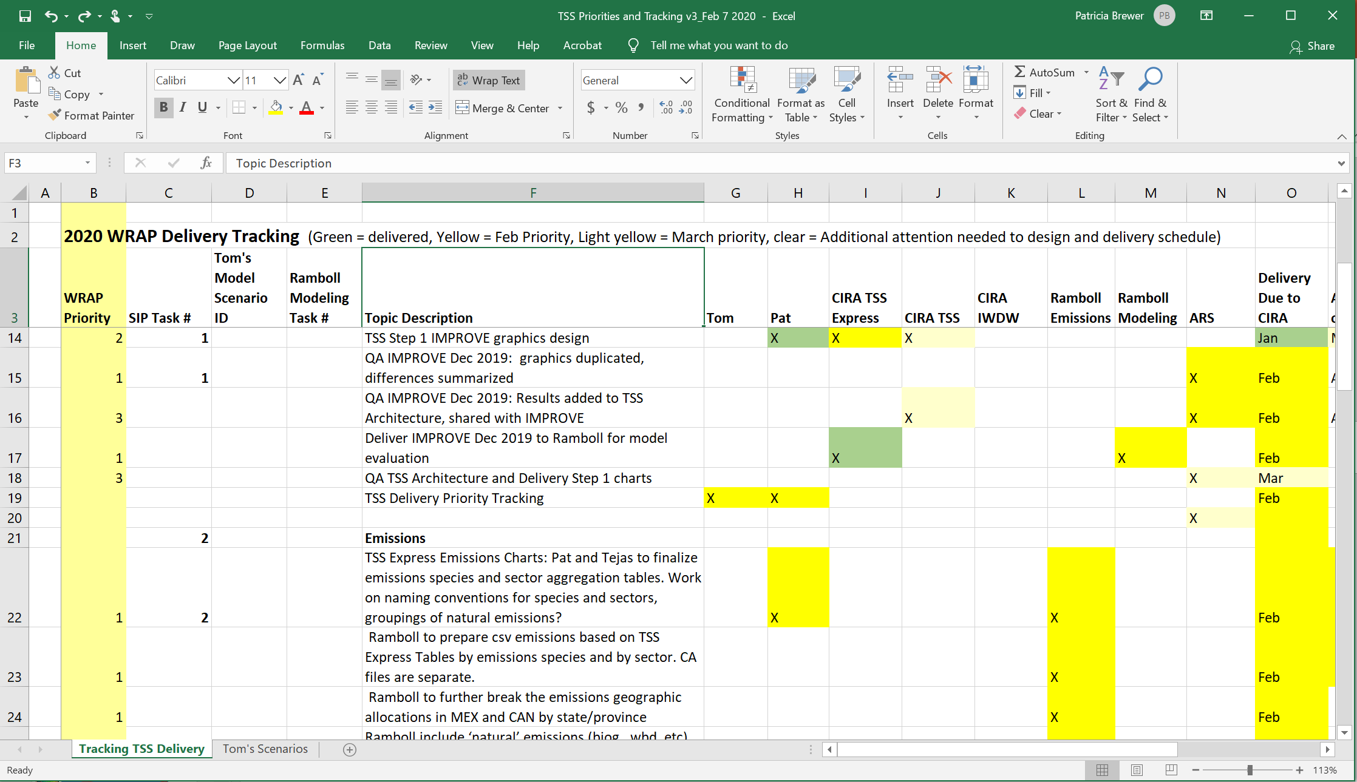
Stage Directions: Who, what, where, when

